Slide 1
BLURRED LINES IBL PROJECT
Interdisciplinary Connections Between AP US History and AP Language & Composition

Slide 2
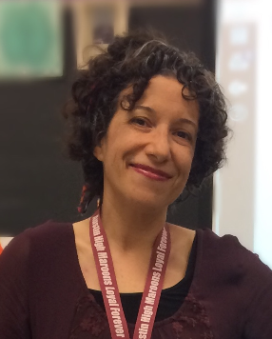
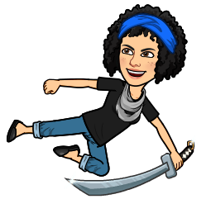
Nadine Cooper
Education
BA: Literature & Communications, Minor in Education. Pace University.
MA: Children’s Literature, Hollins University
MFA: Poetry, Texas State University
Teaching Experience
Taught at various levels since 1997, university, high school, middle school, and pre-school.
Current Teaching Experience: Austin High AGS
AP Language and Composition since 2014
Adjunct at Austin Community College to teach dual credit college English

Slide 3
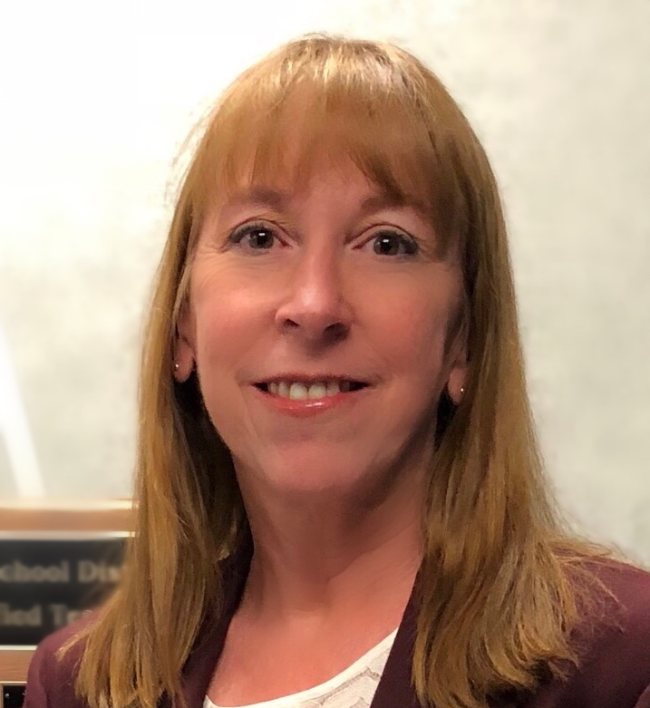
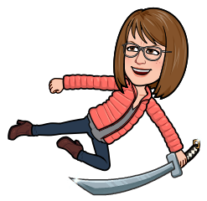
Cherry Whipple
Education
BS: Applied Learning & Development, UT Austin
MAT: Teaching US History, Ashland University (current)
Teaching Experience
Taught preschool, middle school, high school
Current Teaching Experience: Austin High School and AGS
AP US History since 2006
UT OnRamps 2017-2018 (dual enrollment affiliate)
Professional Experience
AP Reader since 2014
Innovative Media & Technology Department Chair
Subject Matter consultant for multiple US History textbooks (American Pageant, Visions of America, American Stories, Created Equal)

Slide 4
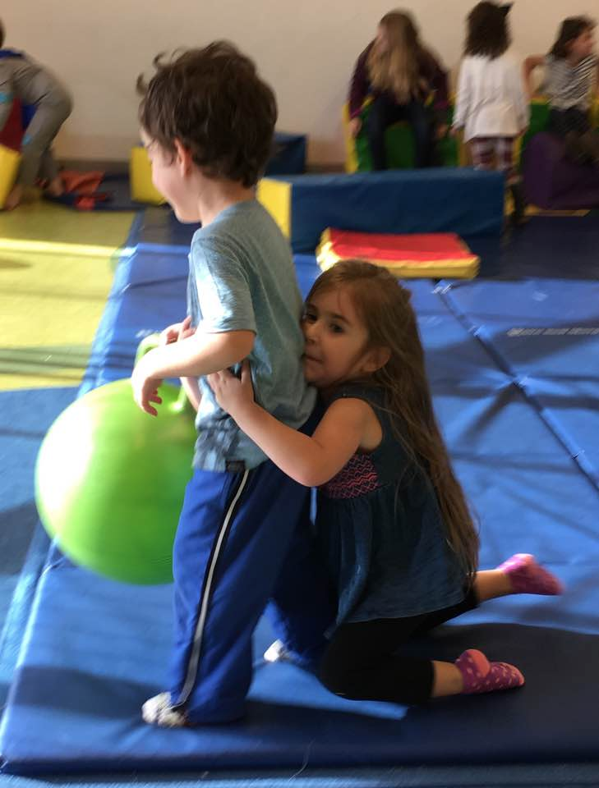
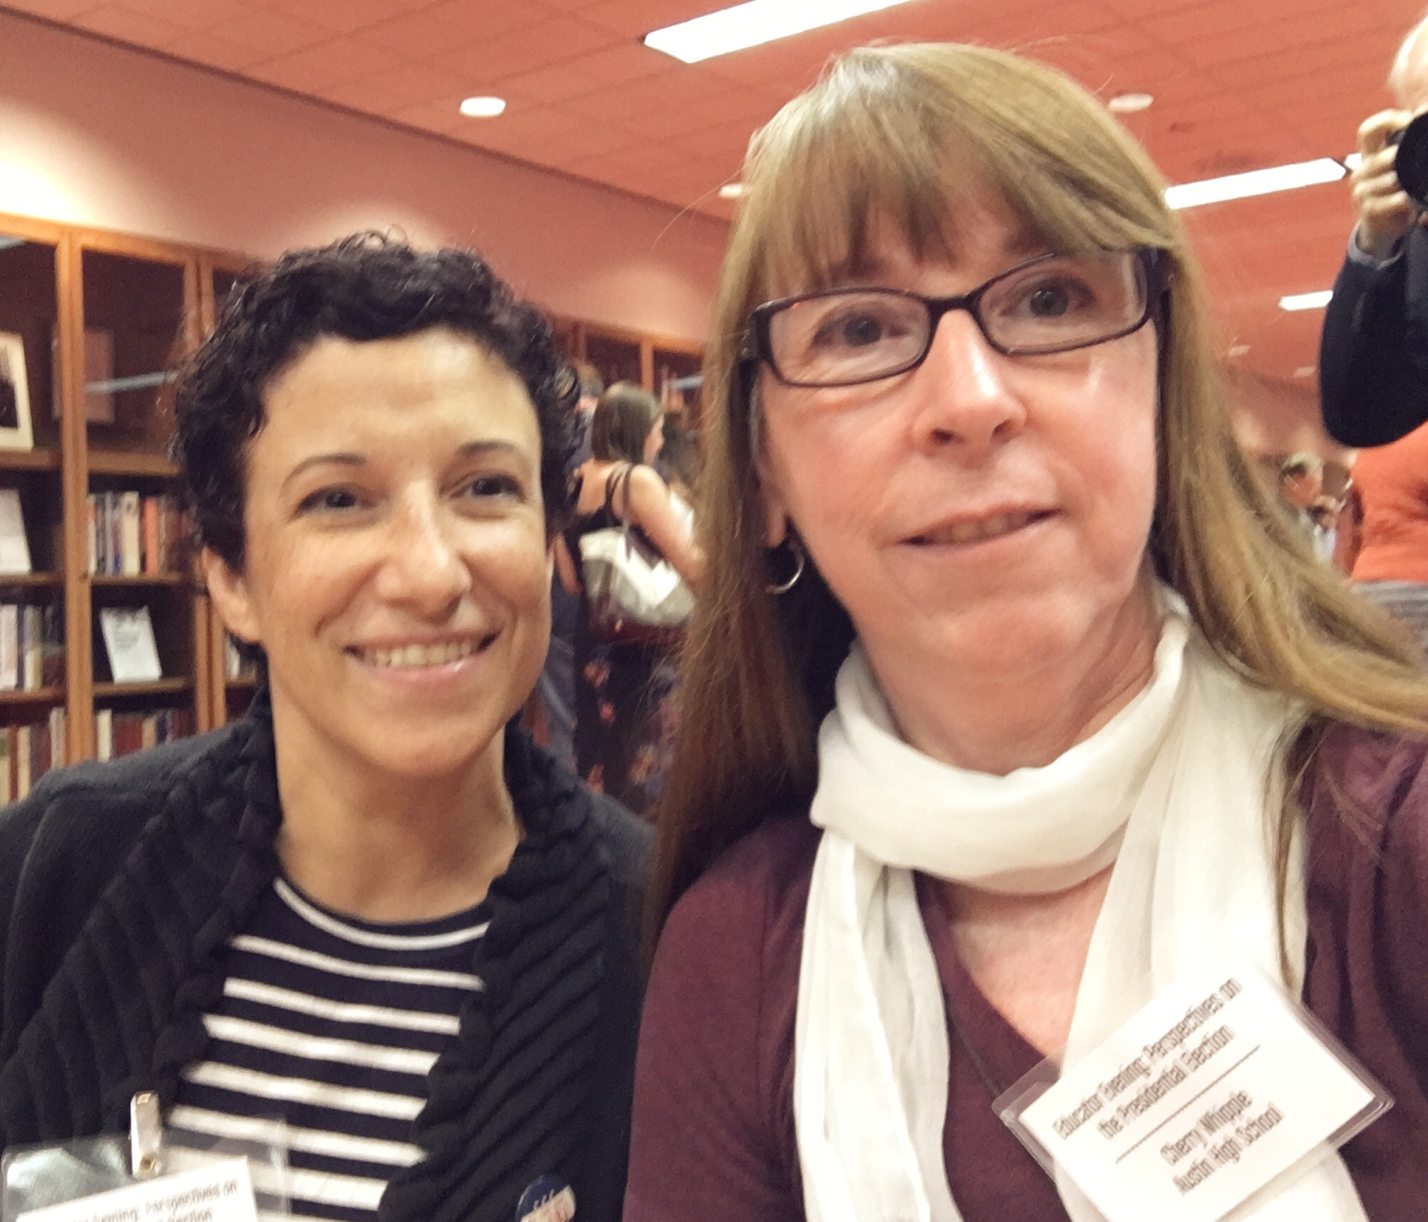
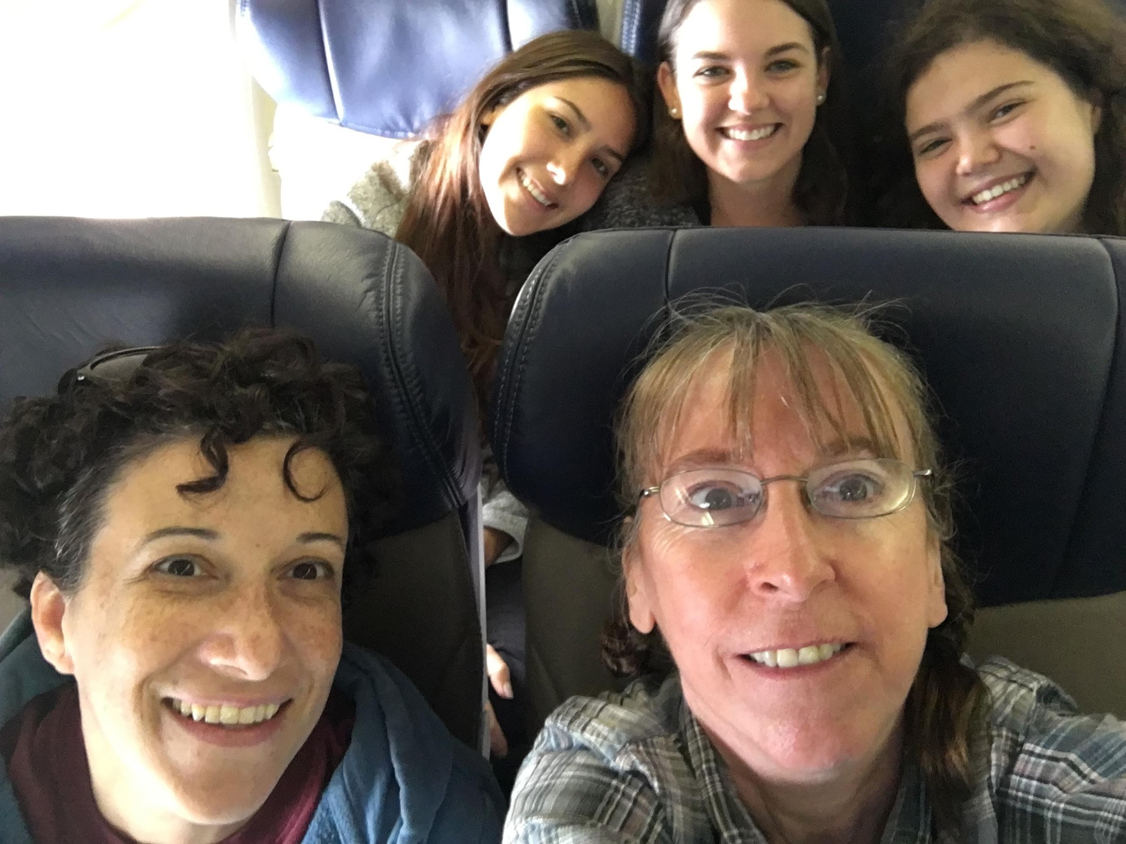
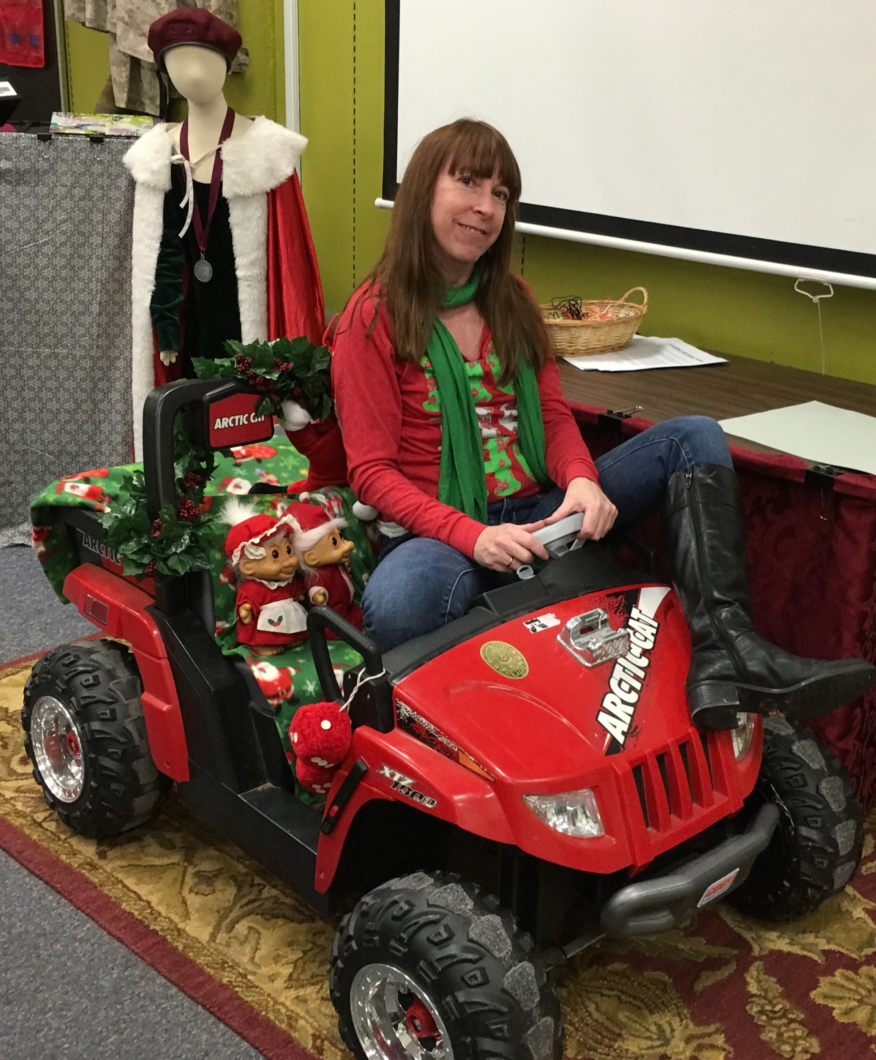
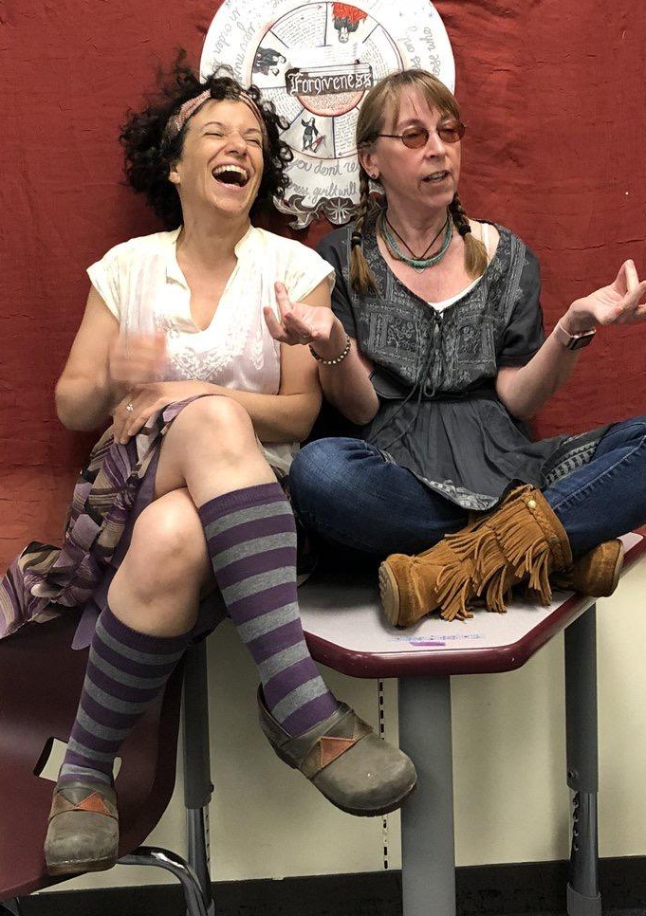
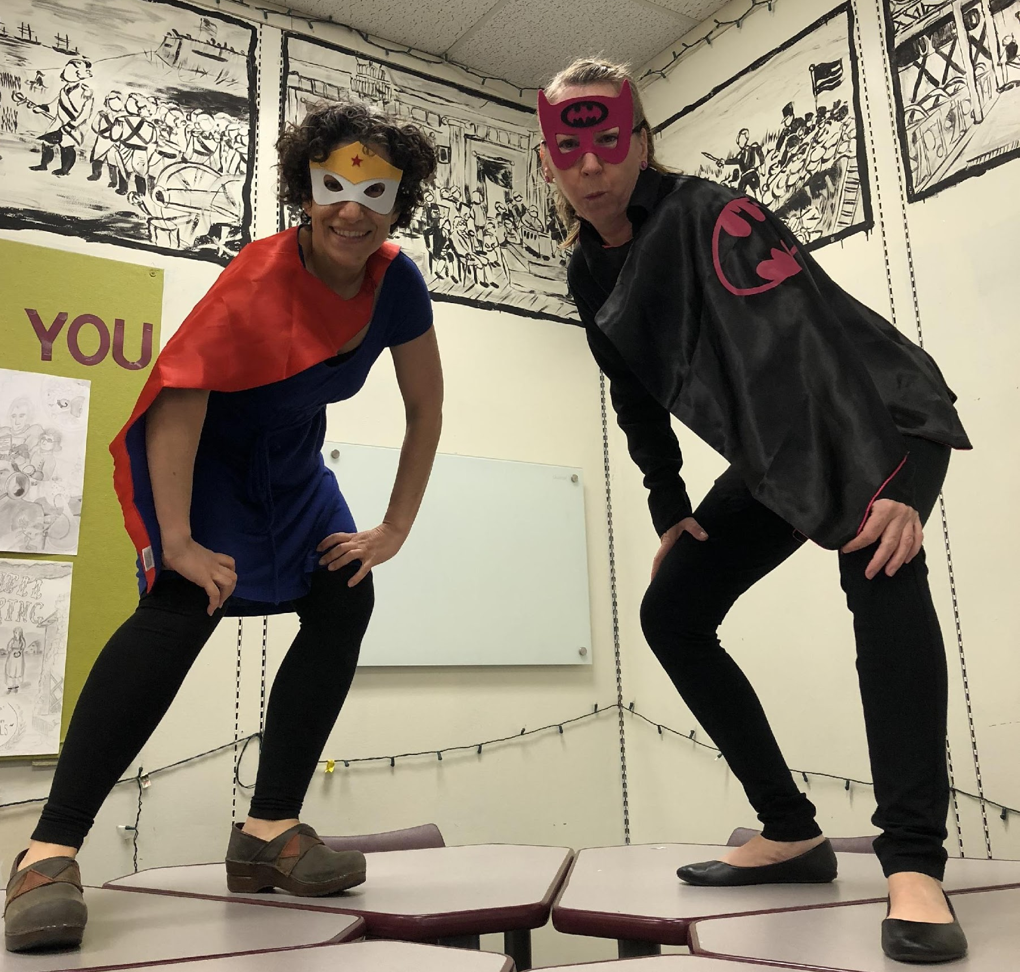
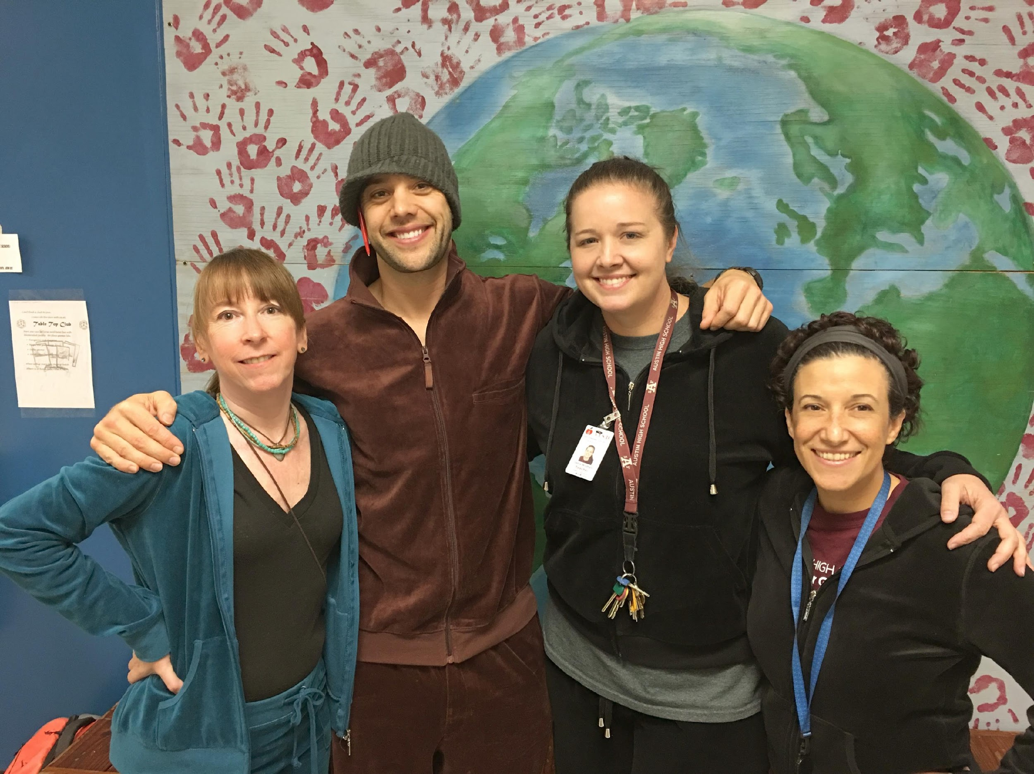

Slide 5
Focus and Travel
New Orleans (March)
Service - Hurricane Katrina neighborhood and park clean-up
Project - Diversity of the city represented diversity of US Research and Evening Presentation to AHS community
Boston (February)
Rhetoric of Culture Project - Immigration from multiple countries, interviewing relevant community professionals, 2-3 page paper plus multimedia project
New Mexico (May)
Service - Navajo Nation
Project - Year-long portfolio with IBL component connected to Native American culture

Slide 6
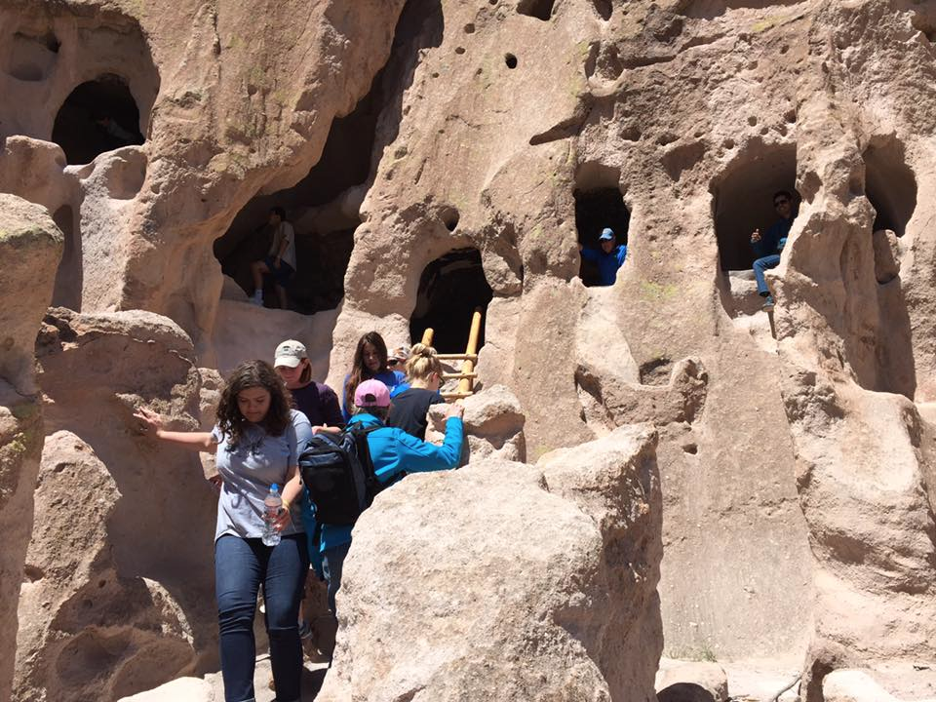
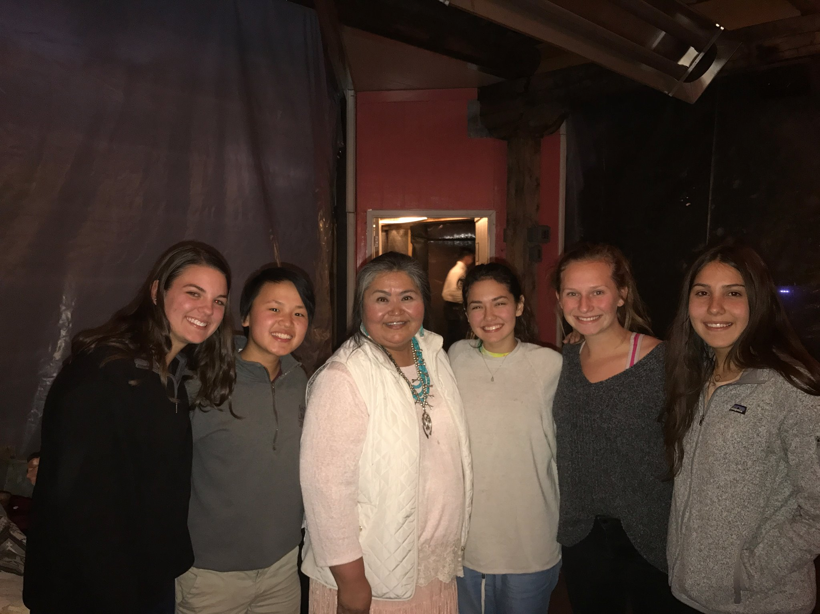
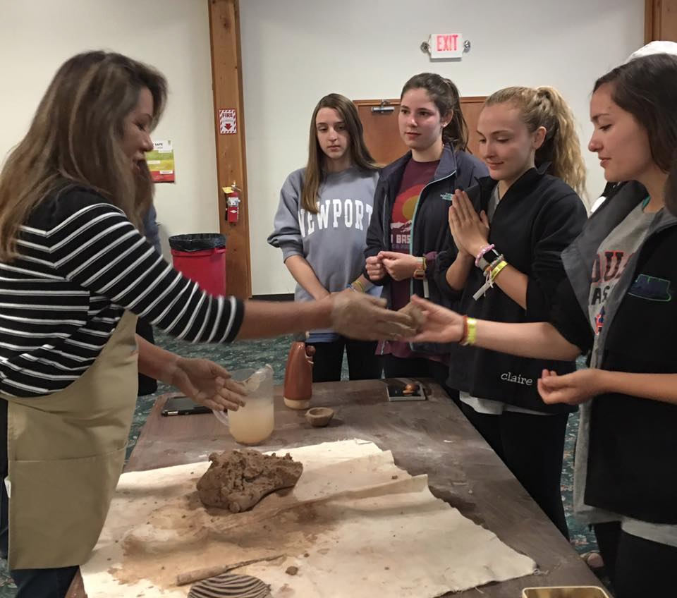
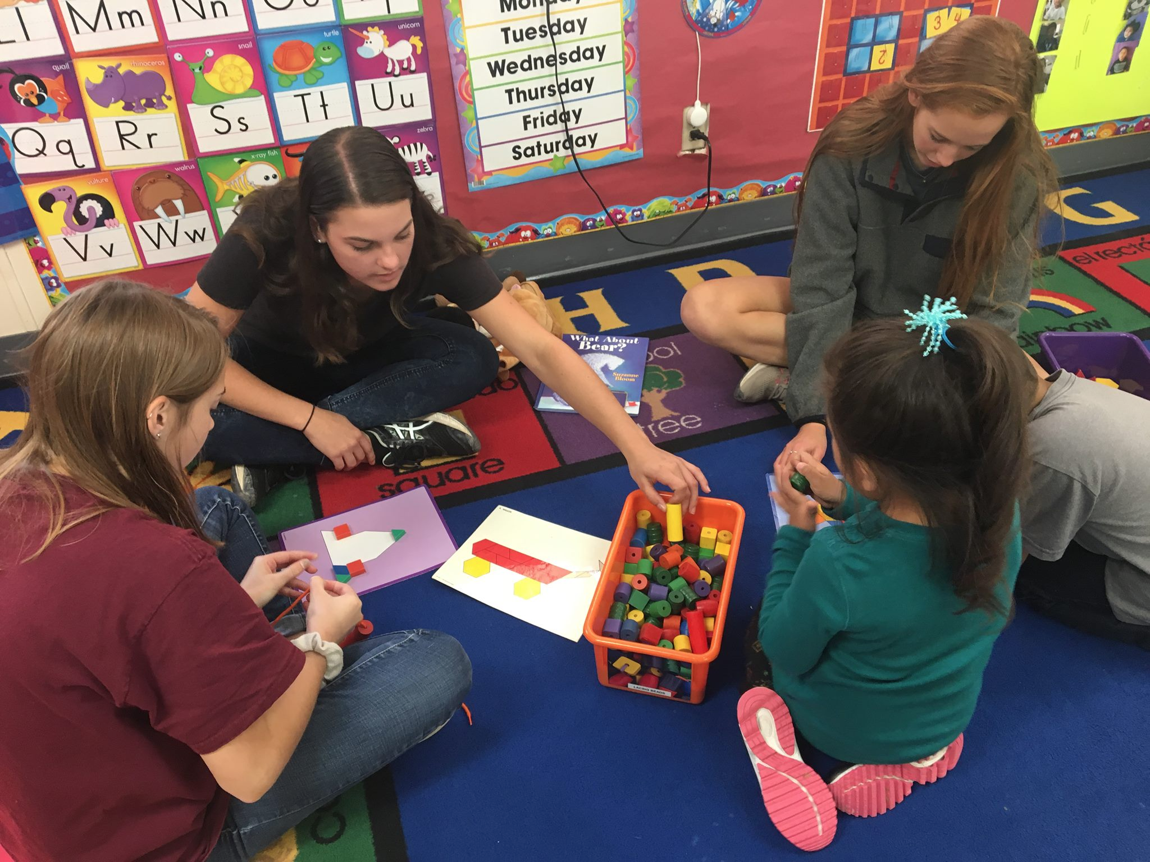

Slide 7
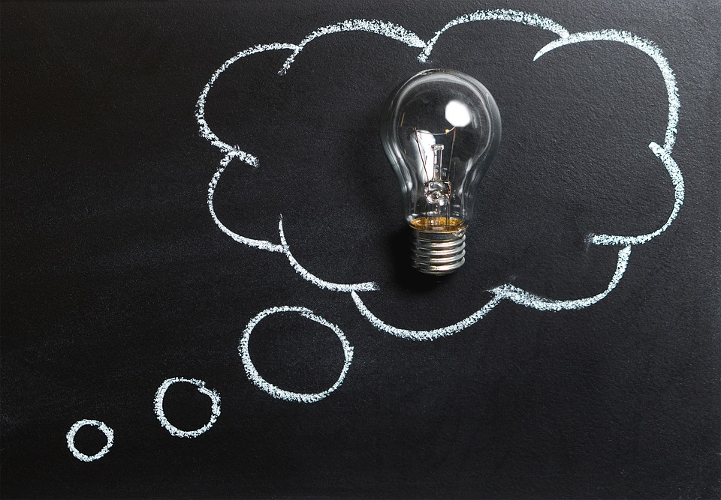
Background
Austin High School teacher (Kat Kelley) developed Inquiry-Based Learning(IBL) Project
Students create the question and design the end project based on an authentic audience
Students create own work flow, with status reports as the teacher takes on the role of facilitator
AGS Modification
Native American culture and issues as the major thematic connection

Slide 8
Goals/Objectives
Students will develop an informative product relating to the general focus area of Native American Life and Identity.
Students will choose an authentic audience and develop their resource with that audience in mind.
Students will use technology to communicate the story of a self selected group in relation to a selected topic, clearly answering their original research question and integrating multiple and diverse sources.
Students will reflect on their own research and production process to assess overall success.

Slide 9
Process
Develop open ended question related to Native American life & culture.
Conduct general research
Develop thesis
Synthesize evidence & opinions from sources to support thesis
Choose a specific authentic audience
Construct a method of delivery for their information
One aspect of product must be audience interactive
Document sources consulted and cited
Deliver product to audience for review/reception.
Reflect on process.
Deliver mini-lessons to the class

Slide 10
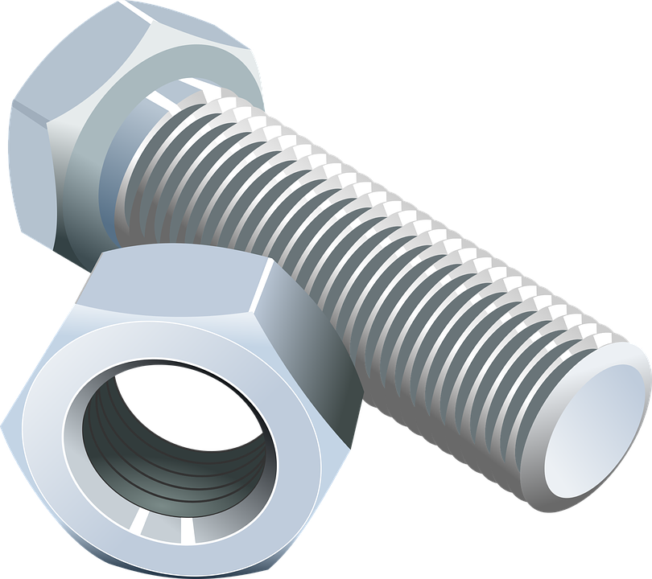
Nuts & Bolts: IBL Timeline
Block 1 & 2: 1/5-1/8: Mini-Lesson: Question generation; groups develop question and begin research (read in class) HW: find relevant research
Block 3: 1/9-1/10: Mini lesson: research, selecting sources, networking for audience; groups review HW research HW: group assigned
Block 4: 1/11-1/12- Research, writing, & project design HW: group assigned
Block 5: 1/16-1/17- building project HW: group assigned
Block 6: 1/18-1/19- Finalizing; Mini-Lesson: MLA HW: group assigned
Block 7: 1/22-1/23 Final work day, delivering product HW: group assigned
Block 8: 1/29-1/30 Update presentations with proof of audience receiving product
Due Date: Projects due 1/31 & 2/1 in English class.

Slide 11
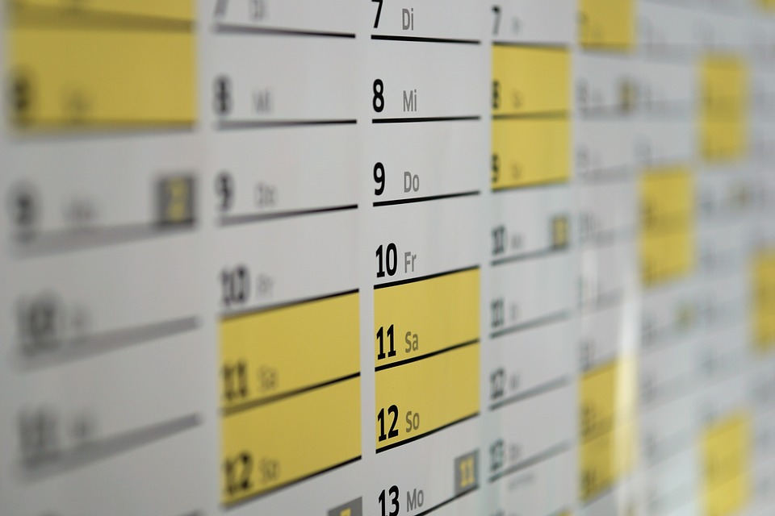
Typical Day
Group Debrief
Show research brought in for HW
Divide and conquer the plan for the day
Mini-lessons (when relevant)
15-30 minutes related to stages of research
Potential topics: how to find sources, source credibility, documentation/MLA, networking, technology, professional communication
Group work time
Student led
Reading time each period
Status reports due online at end of period
Teacher as resource
facilitates through group consultations
design of mini-lessons based on common/frequent issues
Final ”take action” or “communicate ideas” must have teacher approval

Slide 12
Assessment: The IBL Project Rubric
Investigation: Generates questions focused on complex issues, examines texts from multi-dimensional perspectives, and begins to consider possible implications for broader issues. 15%
Insight: Develops and maintains a convincing position on a global or cultural issue or theme that reflects coherent analysis and critical thinking. 15%
Communication: Develops a thesis focused on complex ideas and builds concepts and the most significant and relevant information to present a unified whole. 30%

Slide 13
Formatting and Works Cited: Students correctly cite all sources according to MLA format which is easily accessible. 15%
Authentic Audience:
Students seek out and appropriately contact persons in the outside world interested in their research and network to organize a presentation for their group’s unique authentic audience.
Students organize and present their ideas and information according to the purpose of the research and their audience. Presenters should be conscious of the audiences they address as well as their unique relationships to those audiences as they affect which strategies will be most effective for achieving the desired response. 20%

Slide 14
Collaboration Score: Students demonstrate effective collaboration with classmates through preparedness, goal setting, democratic discussions, and posing and responding to questions that promote divergent, creative thinking. 5%
Individual students’ total scores may be altered by teacher discretion.

Slide 15
In-Class Resources/Activities
Developing a Research Question video: https://www.youtube.com/watch?v=LWLYCYeCFak
Aaron Huey – America’s Native Prisoners of War Ted Talk https://www.ted.com/talks/aaron_huey
Honor the Treaties video https://vimeo.com/47043218

Slide 16
Native American Issues in Various Media
Indian Country Media source
Native Speakers at TED
NextGen Native Podcast
Marlon Brando's refusal of his oscar for "The Godfather"_ 1973
Wounded Knee 1973 from PBS "We Shall Remain"
Speech by Russel Means to Senate in 1989
Ogala Lakota peaceful protest against the legalization of alcohol
Native News Online- current news
Camille Nighthorse
Standing Rock

Slide 17
Group 1 Reflections & IBL details
Rachel portfolio entry for IBL Project
http://ags18williamsr.weebly.com/ibl-project.html
Laura portfolio entry for IBL Project
https://ags18hoelterl.weebly.com/take-action.html
Kailea portfolio entry for IBL Project
https://ags18finkk.weebly.com/take-action.html

Slide 18
Sample Status Reports: Group 1/Day 1
Rachel -
We researched Aztec beauty standards and compared them to European beauty standards that we know.
http://www.mexicolore.co.uk/aztecs/home/aztec-women
I learned what beauty standards were like in Aztec times.
Laura:
I researched, "This Is Why I'm Hot!"
While reading this article, I learned about a native woman's perspective on westernization on Native American woman. Their idea of beauty has changed over the years because it has become a common idea that pale skin, and thin body is the norm for what makes one beautiful.
https://indiancountrymedianetwork.com/culture/thing-about-skins/this-is-why-im-hot/
Kailea:
"This Is Why I'm Hot!"
I learned that many women's definition of "hot" is the Eurocentric view of beauty. Even the titled "Hottest Native" had fake breasts and bleach blonde hair because that is what majority of people think beauty is.
https://indiancountrymedianetwork.com/culture/thing-about-skins/this-is-why-im-hot/

Slide 19
Sample Status Reports: Group 1/Day 3
Rachel -
Today we read about what common European beauty standards are.
It is connected to our topic because it gave us a frame of reference.
Our homework is to finish the mural.
Our group plan is to work on our website.
One thing we are taking away is to email the owner of the body shop.
Laura:
Today I read "The Cultural Implications of Beauty" by Meera Jain.
It connected to my topic because she discusses Western Cultural Ideals and how people have shaped their lives to fit in with societal norms.
During the weekend, my group wants to get together at least once, since Rachel has only been to on of the classes where we talked about this project. We will fill her in and try to come up with a plan for our mural.
On Tuesday, we are going to bring in all of our research and plan which ones we are going to use.
I didn't know how low the employment level was on certain reservations.
Kailea:
For today's class I read about the To'hajiilee tribe and how it's connected to modern media (Breaking Bad).
It's connected to our topic about native american beauty standards because we want to focus on the To'hajiilee tribe and how it's affected by western society.
My homework for the weekend is to get together with my group and brainstorm about the mural.
We'll address each of our research resources and pick out our concrete sources.
I didn't know that Abraham Lincoln was so horrible to Native Americans.

Slide 20
Group 2 Reflections & IBL details
Avni portfolio entry for IBL Project
https://ags18singha.weebly.com/take-action.html
Jackie portfolio entry for IBL Project
https://ags18tothj.weebly.com/take-action.html

Slide 21
Sample Status Reports: Group 2/Day 1
Avni –
I researched tragic events in Native American history that has primarily gone unnoticed by the media and general public. These events, laws, and stories may change the public perception of certain leaders in history.
I researched the hanging of the Dakota 38 and found some hypocrisy with President Lincoln's mission for the abolition of slavery and equality and his orders to execute tens of Native people with little basis. I also learned that many lawmakers throughout history, such as California Governor Peter H. Burnett, have openly boasted about their racist views and ambivalence towards the future of native people.
http://nativenewsonline.net/opinion/hanging-dakota-38-troubling-legacy-president-lincoln/
http://endgenocide.org/learn/past-genocides/native-americans/
Antara –
Native American Holidays
I learned that some Natives do celebrate Thanksgiving but it has a much different meaning. One man called it "a death of culture" and they celebrate their survival.
https://www.nytimes.com/2017/11/23/us/thanksgiving-for-native-americans-four-voices-on-a-complicated-holiday.html
Jackie –
https://govinfo.library.unt.edu/ngisc/research/nagaming.html
https://www.narf.org/indian-gaming/
http://www.nber.org/digest/feb03/w9198.html
I researched why Native Americans have casinos on their reservations, and how casinos and the revenue from them affect Natives, such as the employment rates, the total income as a whole for the active population, and how not many out of the whole population actually are involved in the casino-gambling topic. Apparently the US only has so much control on the laws of gambling so if the casino is located on an Indian reservation, which is why it is more common. There are more than half of the total reservations in America that have nothing do with casinos as many are very small and in rural areas with small populations. The areas with casinos make billions annually and employ many people.

Slide 22
Sample Status Reports: Group 2/Day 3
Avni –
I read an article about American history from a native speaker's pov.
This connected to my topic because we are exploring how native understanding of tragic, hidden events differs from mainstream American understanding.
I need to research on Google Scholar, think about possible thesis angles, and brainstorm two possible product options.
Finalize thesis, finalize product decision, pick audience.
I learned from the Ted Talk that 90% of Native Americans live below the federal poverty line.
Jackie –
I Read two articles relating to how presidents have effected Native Americans throughout history. One article was about Andrew Jackson from a Native's persepective, and the other was an article about Trump's most known offensive comments relating Native Americans, so we have a historical president and the current president. Connects to our topic of the history of relationships between Native Americans and the Presidents. Homework for the weekend is to finish conducting research, think up and draft the thesis, and come up with 1-2 ideas for our lesson plan. We will finalize the question and thesis, maybe decide on the lesson plans, and consolidate research to start putting together on a medium to present. In the TED talk Aaron spoke about how the issue of mistreatment for the Natives isn't something that we can so easily solve anymore because it has been left alone and ignored for so long, I think this really shows how far along we have messed up, and that we can just solve the issue with money and a few volunteer groups.

Slide 23
Troubleshooting
1-2 group members not working
One group member doing most of the work
Entire group wasting time
Academic challenges
Narrowing topic
Trouble finding appropriate research sources
Lower reading/writing skillset

Slide 24
New Year Changes
Start at the beginning of the year = long term research project
Work on background research and develop question in Semester 1
Fine tune research and develop answer/product in Semester 2
Potential to integrate with National History Day (student choice)
Triumph and Tragedy in History theme for 2018-2019

Slide 25
Take a minute…
To brainstorm topics, texts, projects already used that could potentially be modified to be IBL in your classroom

Slide 26
Q and A
Questions?
Do we have any door prizes??? Yes we do!

